Slide 1

GEOG 4/590: Geospatial Data Science
Lecture 3: Network data analysis
Email: jryan4@uoregon.edu
Office: 163A Condon Hall
Office hours: Monday 14:00-16:00

Slide 2
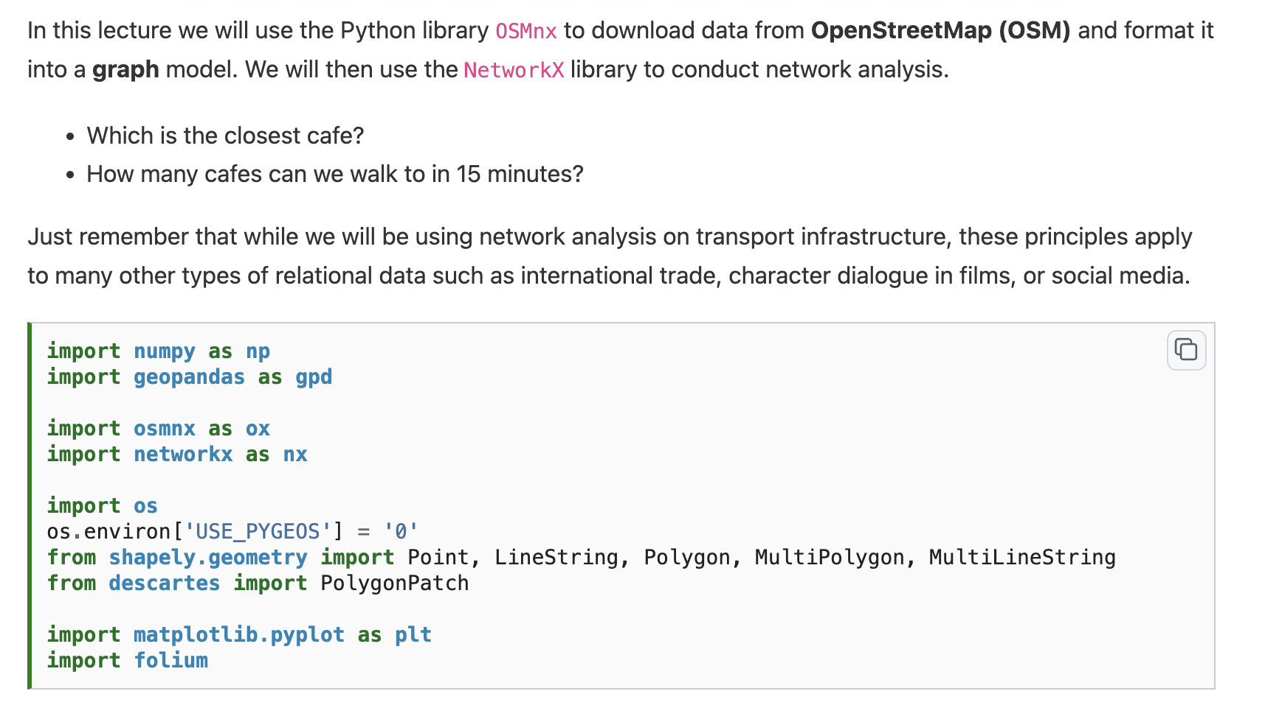

Slide 4
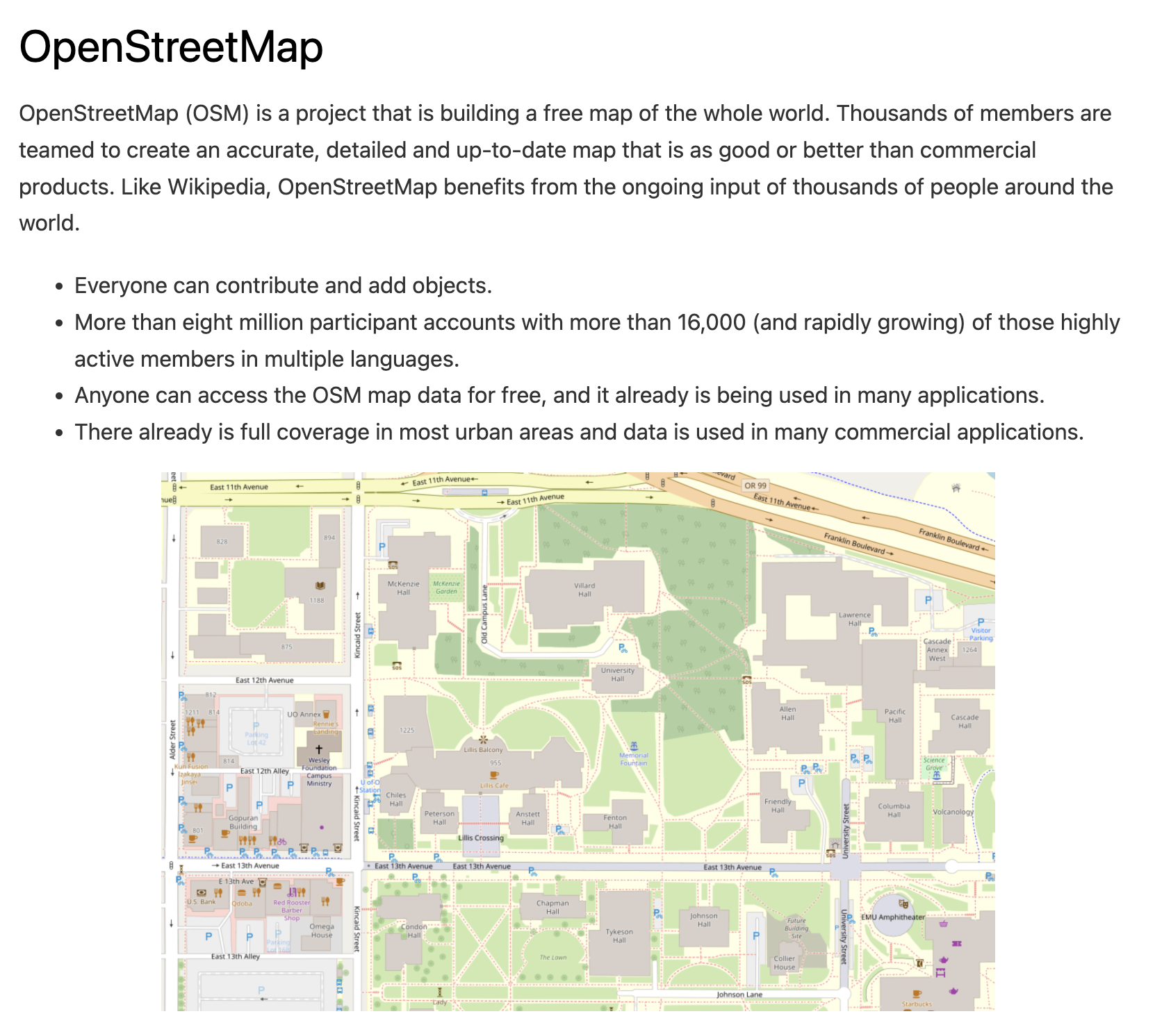
Notes:
OSM is an extremely rich source of geospatial data. It works on the Volunteered Geographic Information principle.

Slide 5
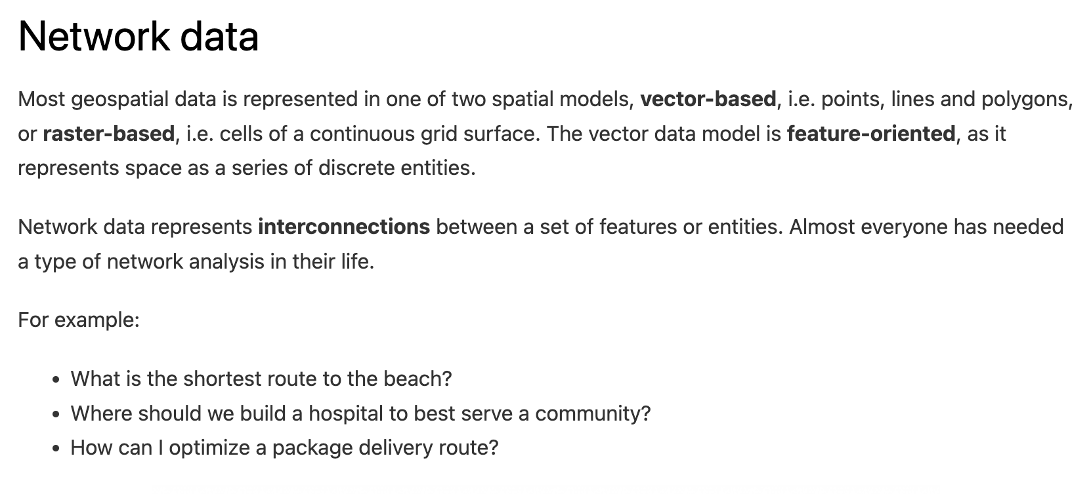
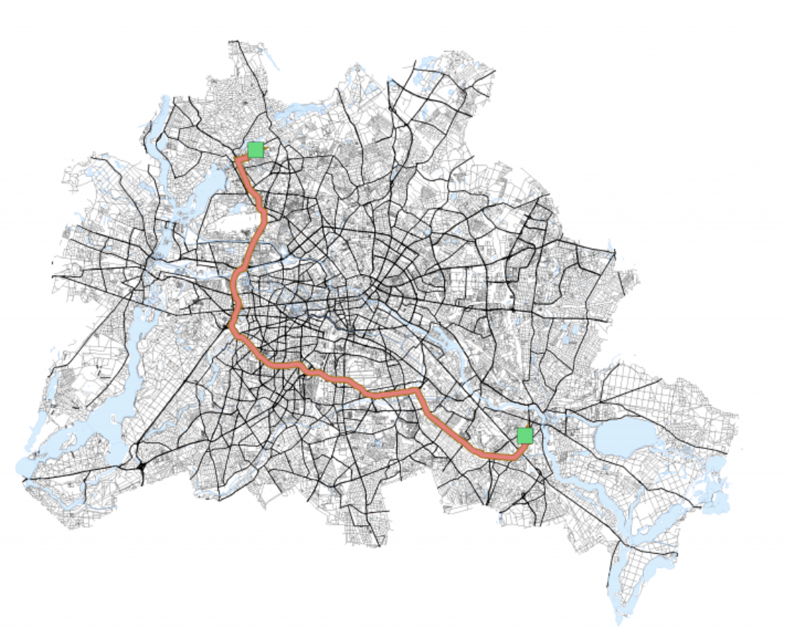

Slide 6
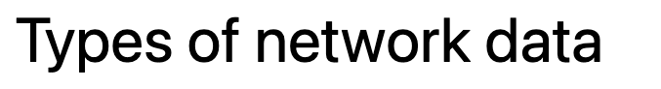
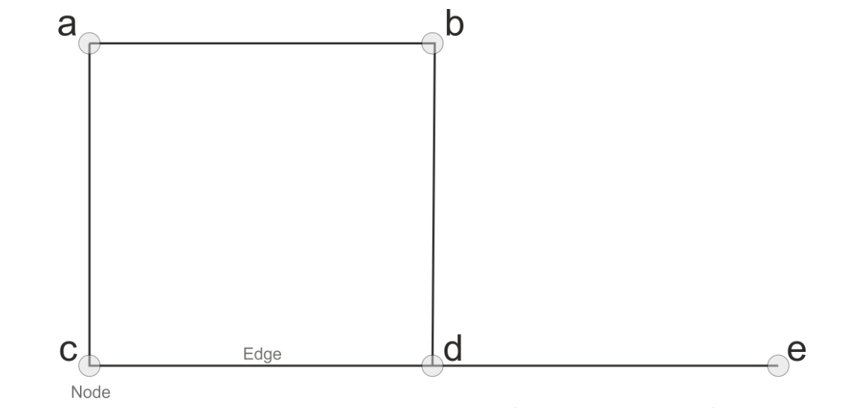

Slide 7
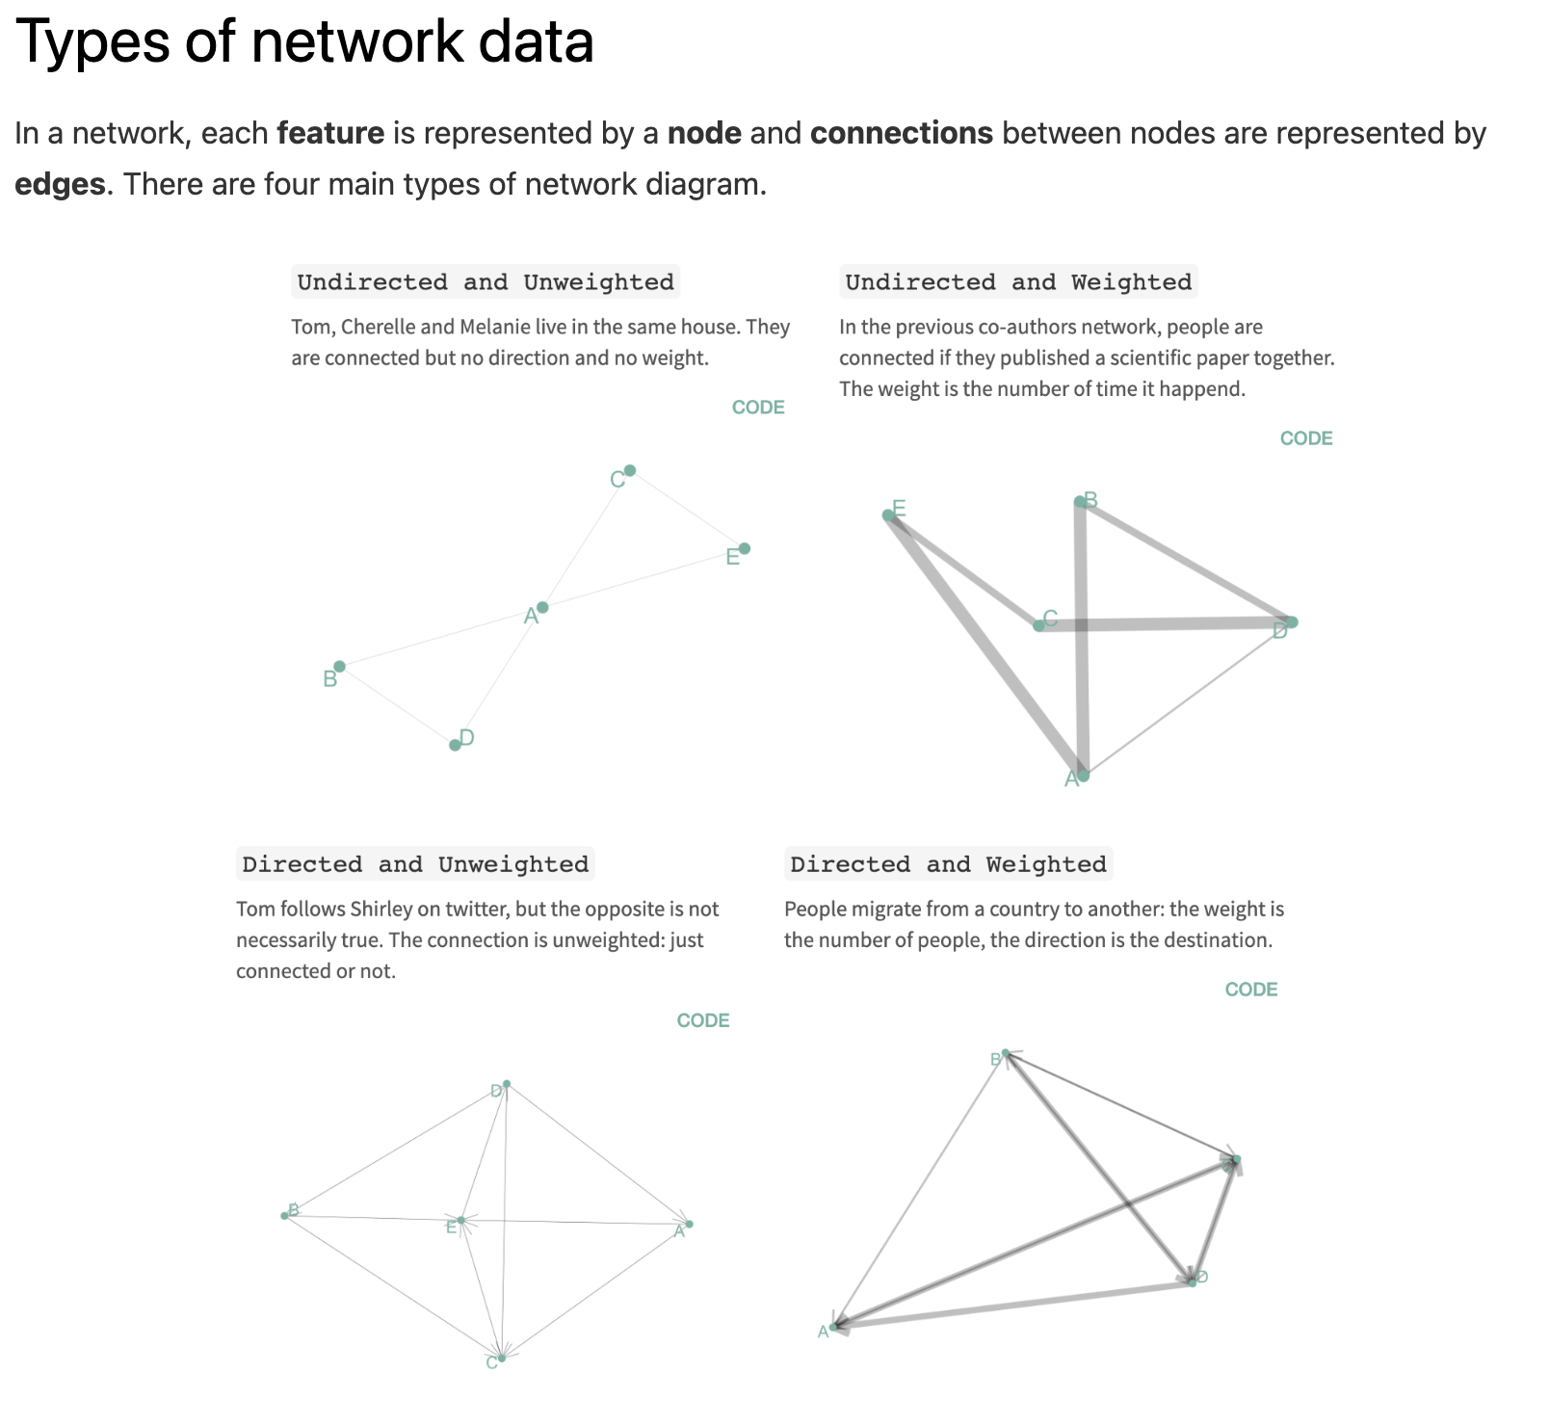

Slide 11


Slide 12
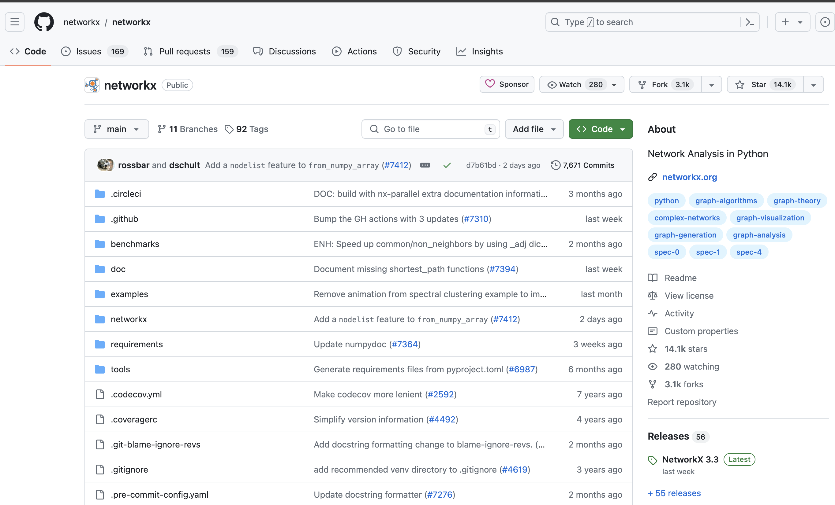

Slide 13
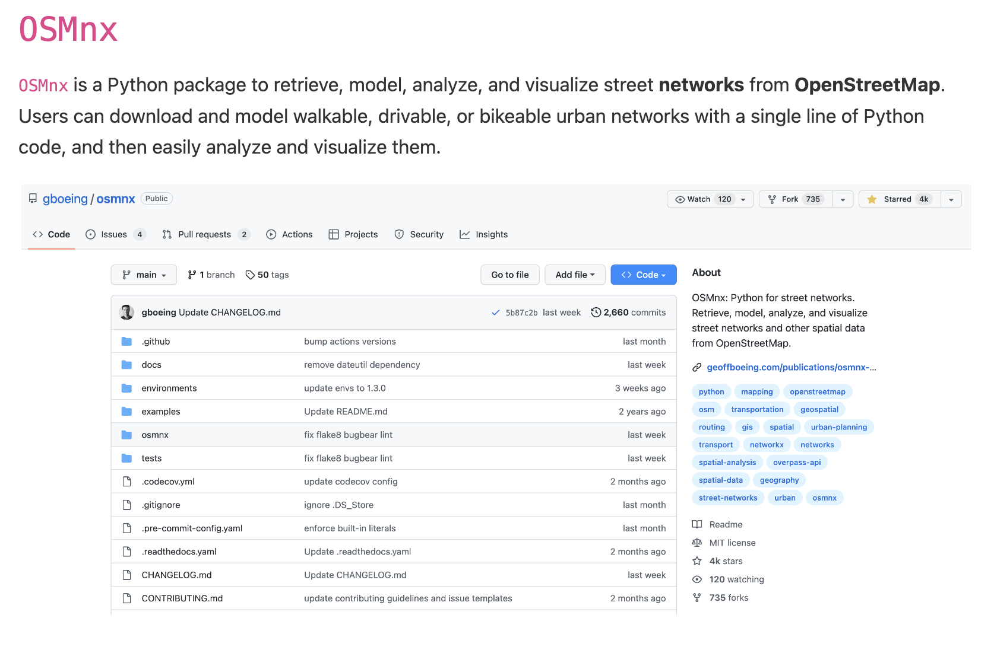

Slide 14
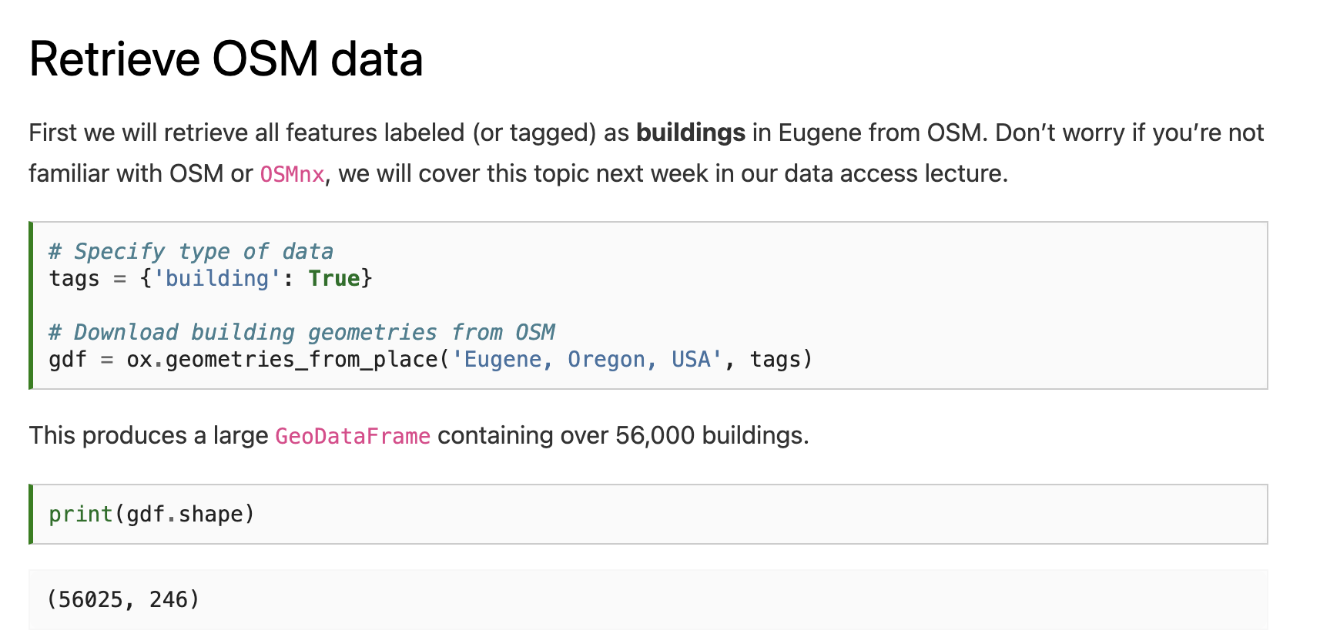

Slide 16
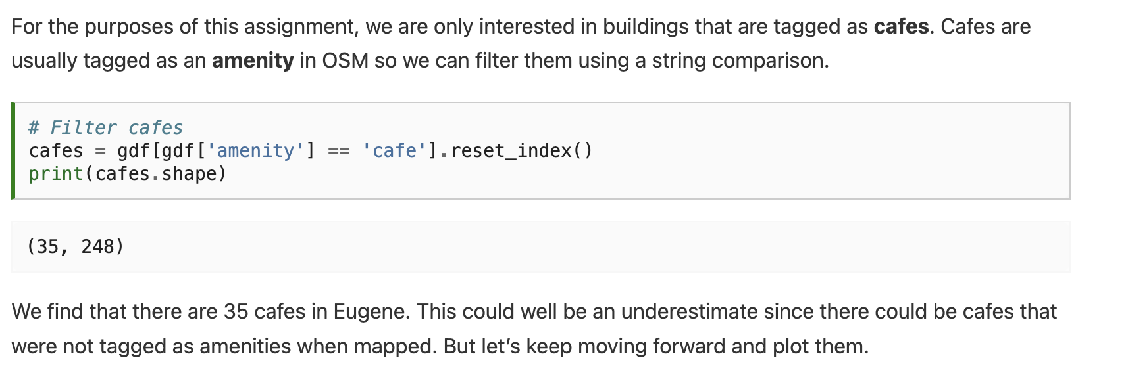

Slide 17
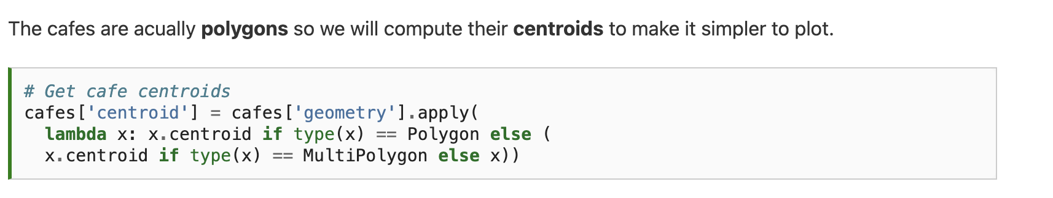

Slide 18
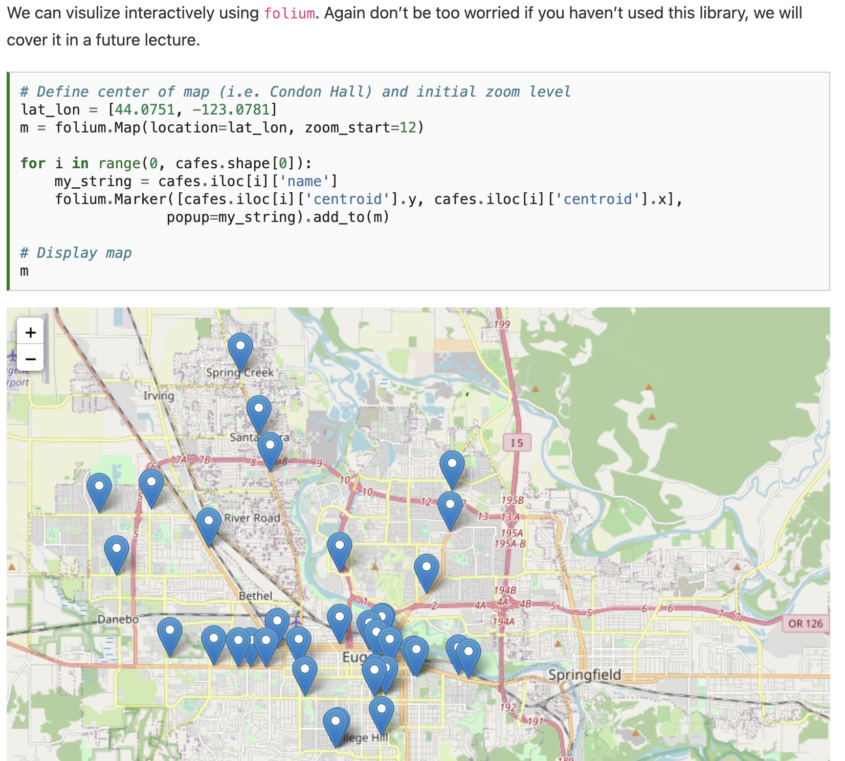

Slide 19
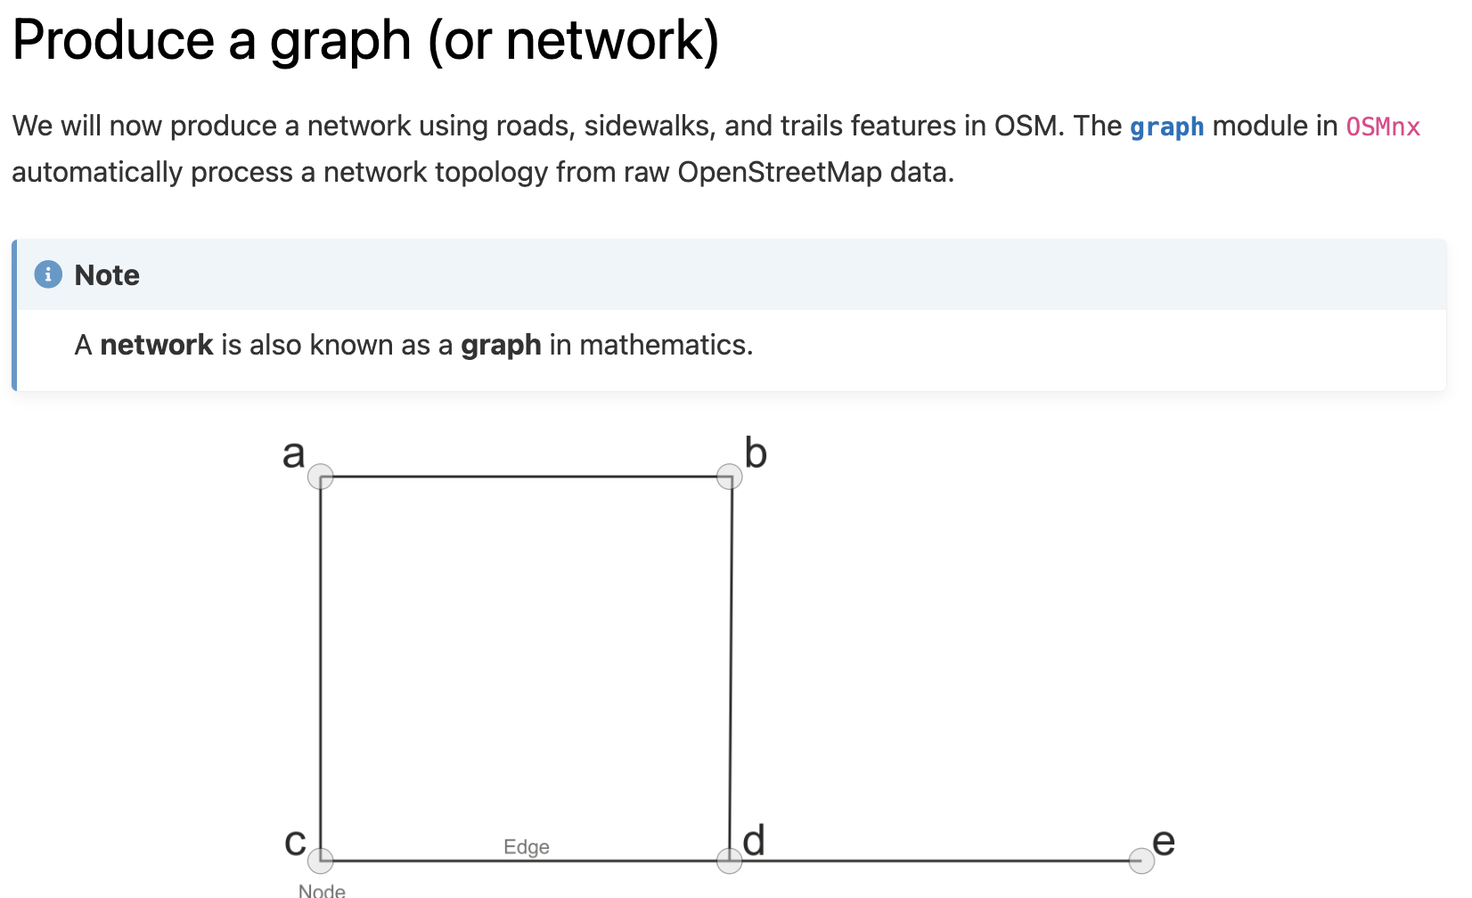

Slide 20
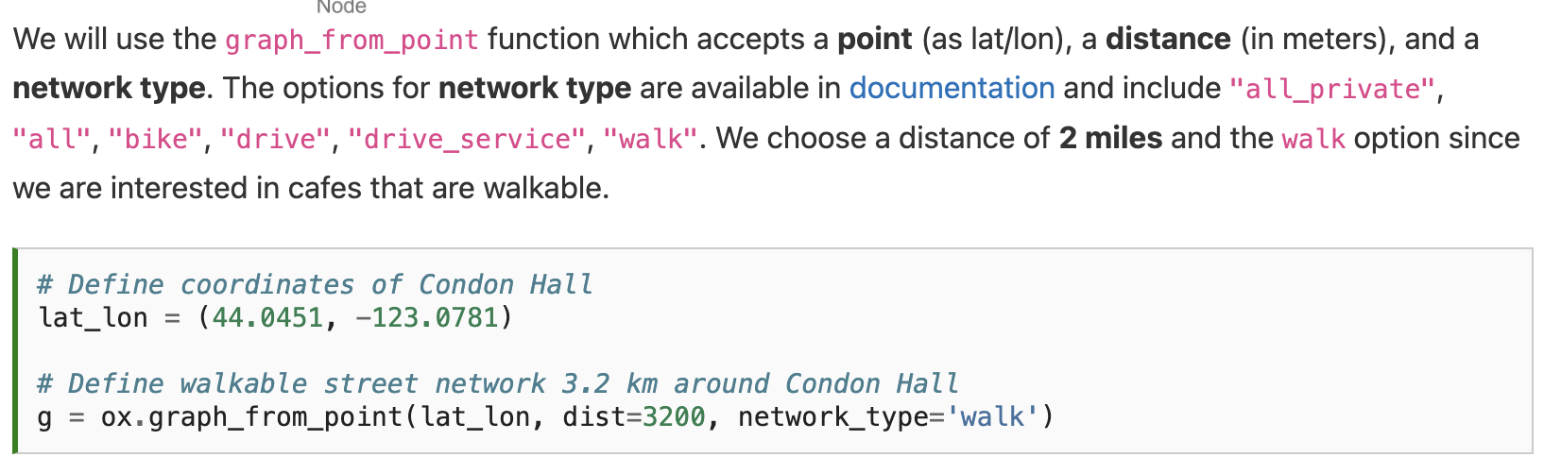

Slide 21
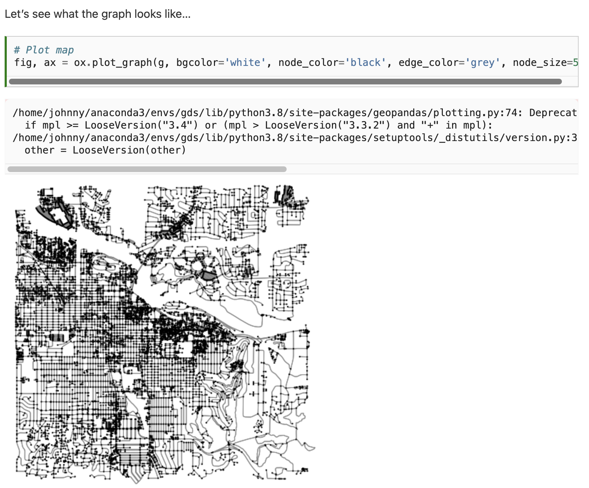

Slide 22
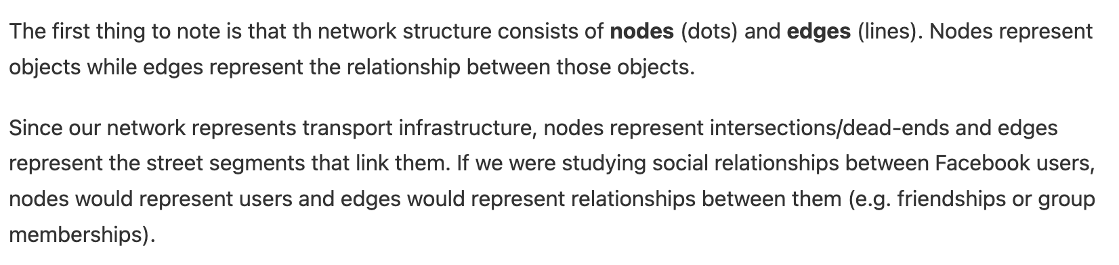

Slide 23
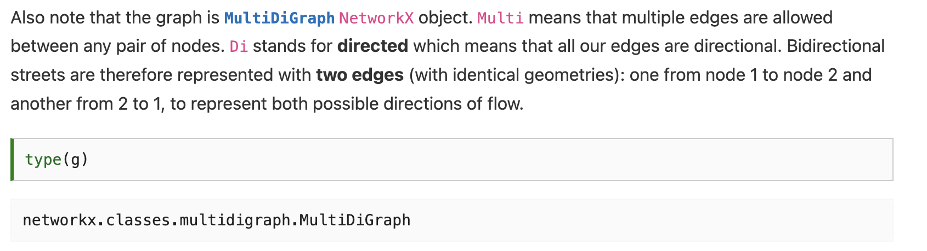

Slide 24
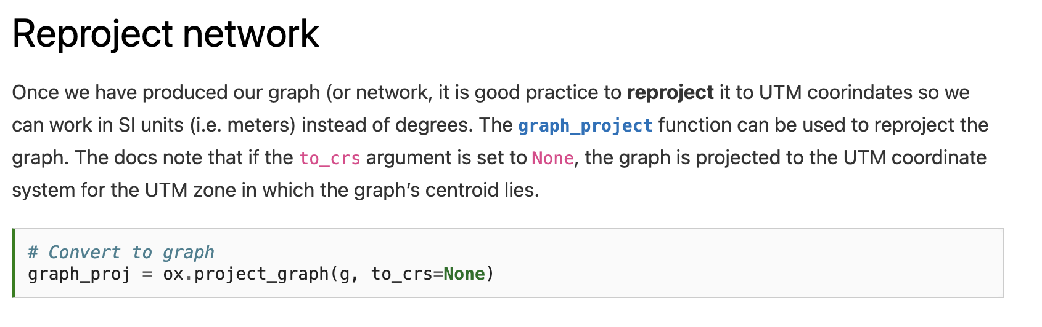

Slide 25
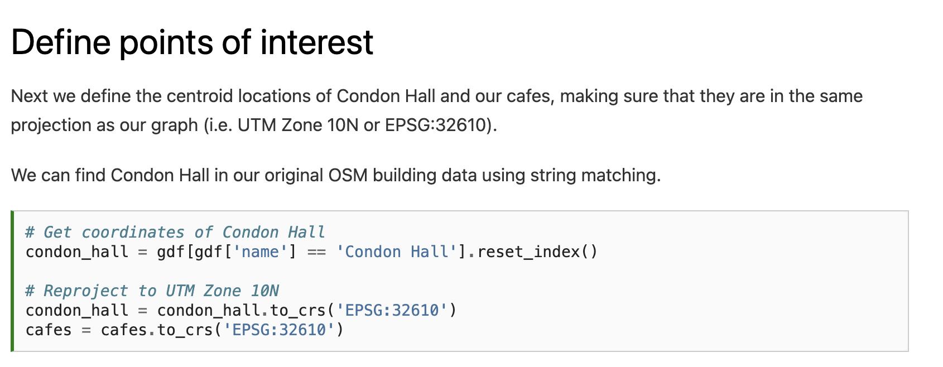

Slide 27
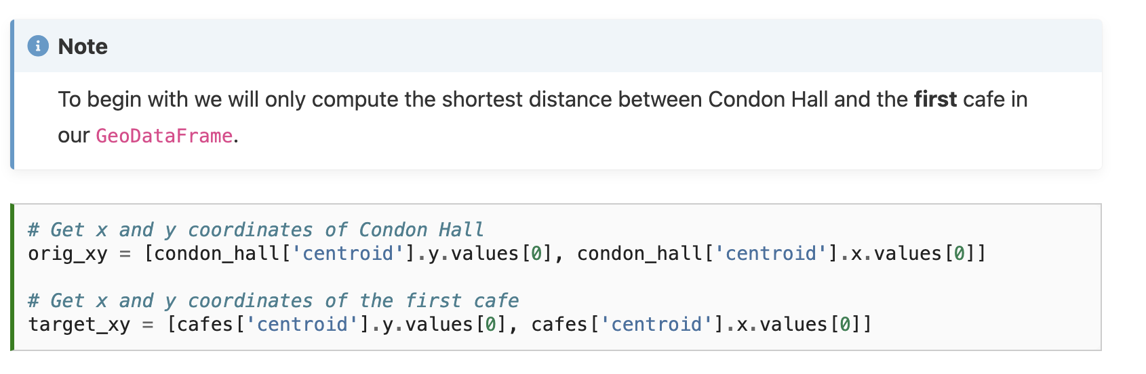

Slide 28
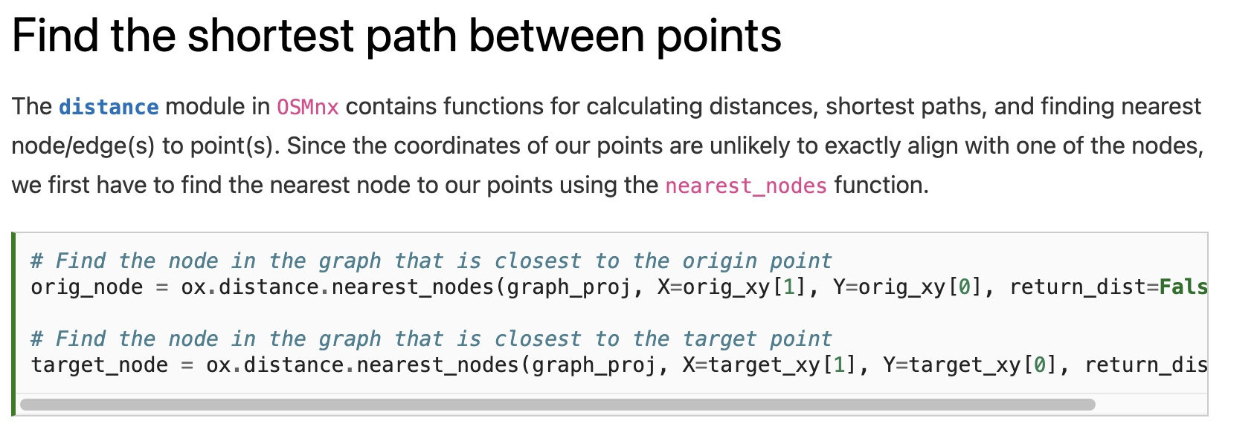

Slide 29
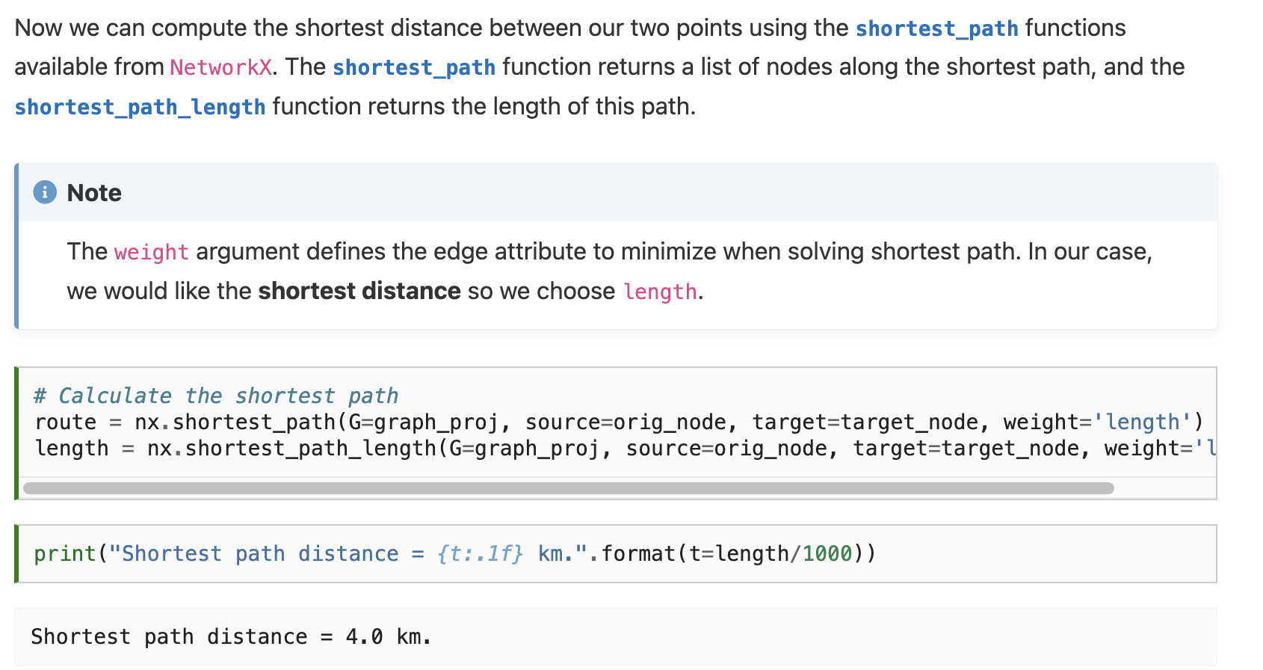

Slide 32
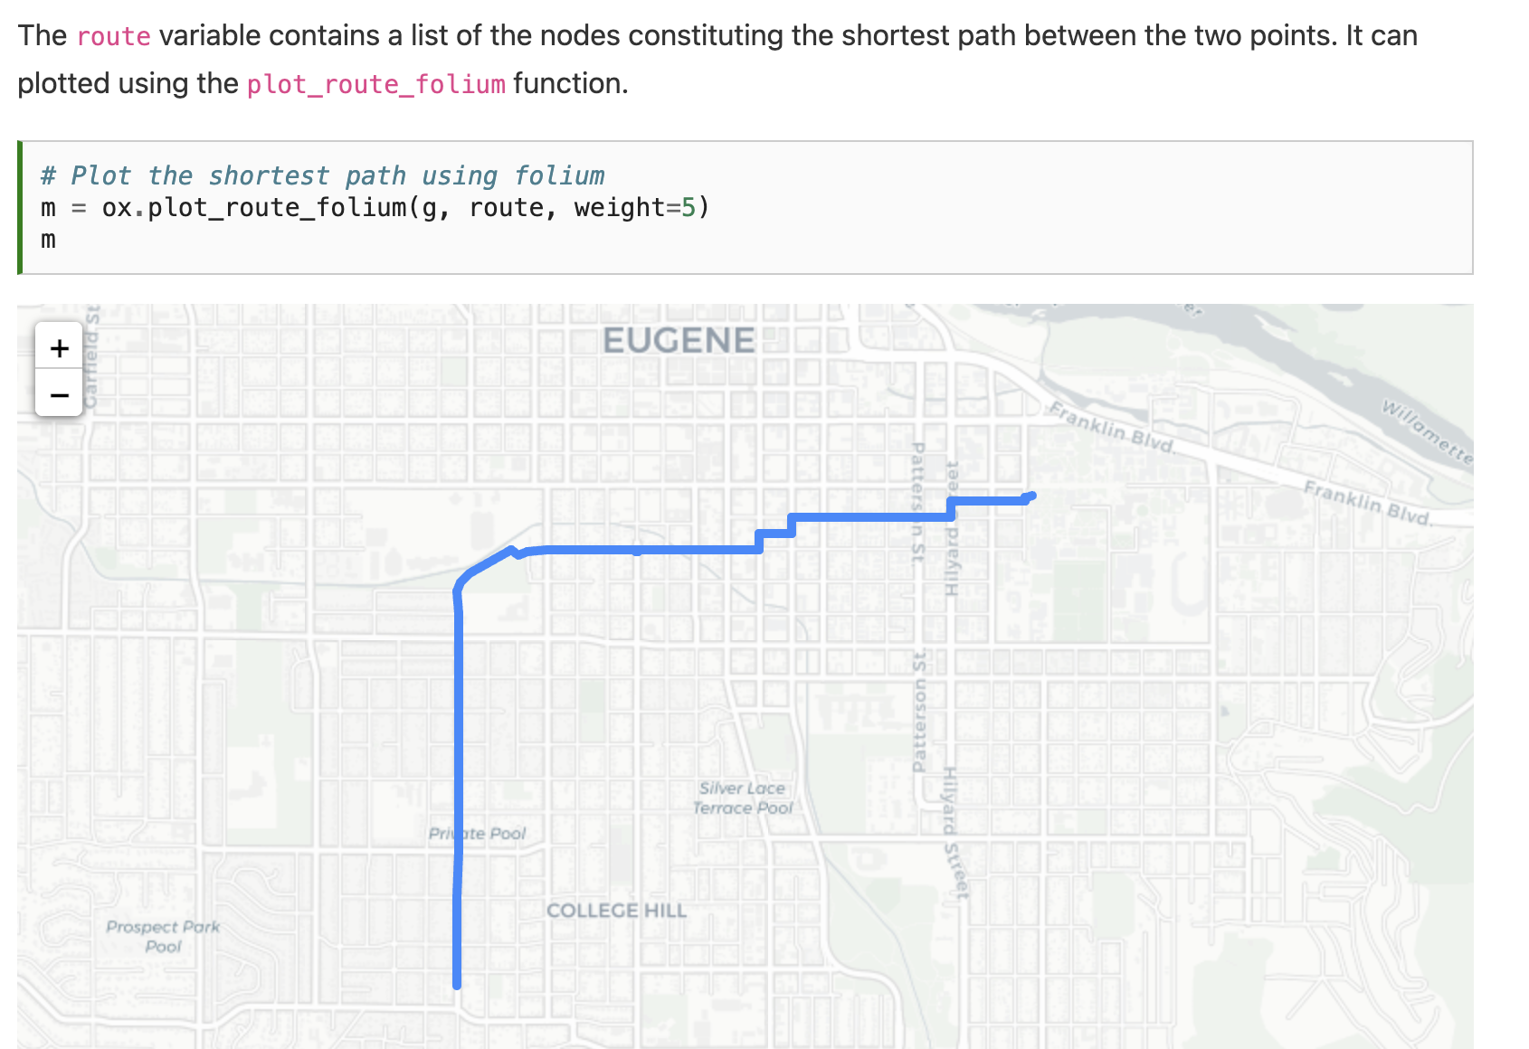

Slide 33
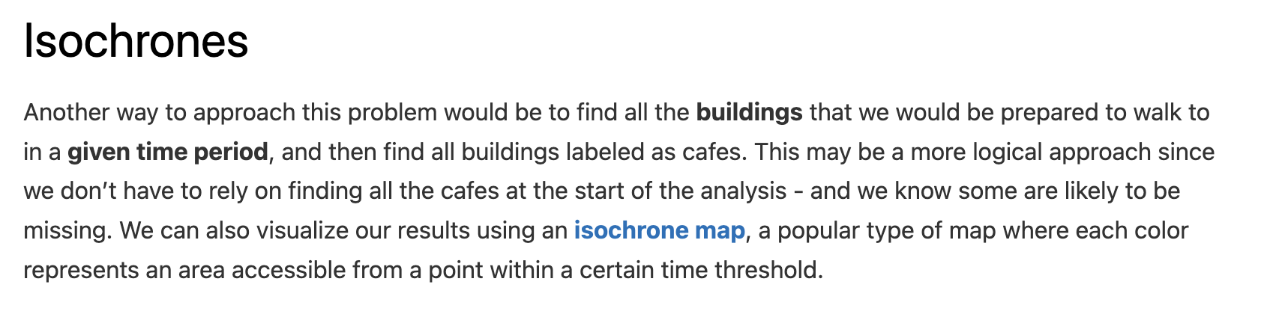

Slide 34
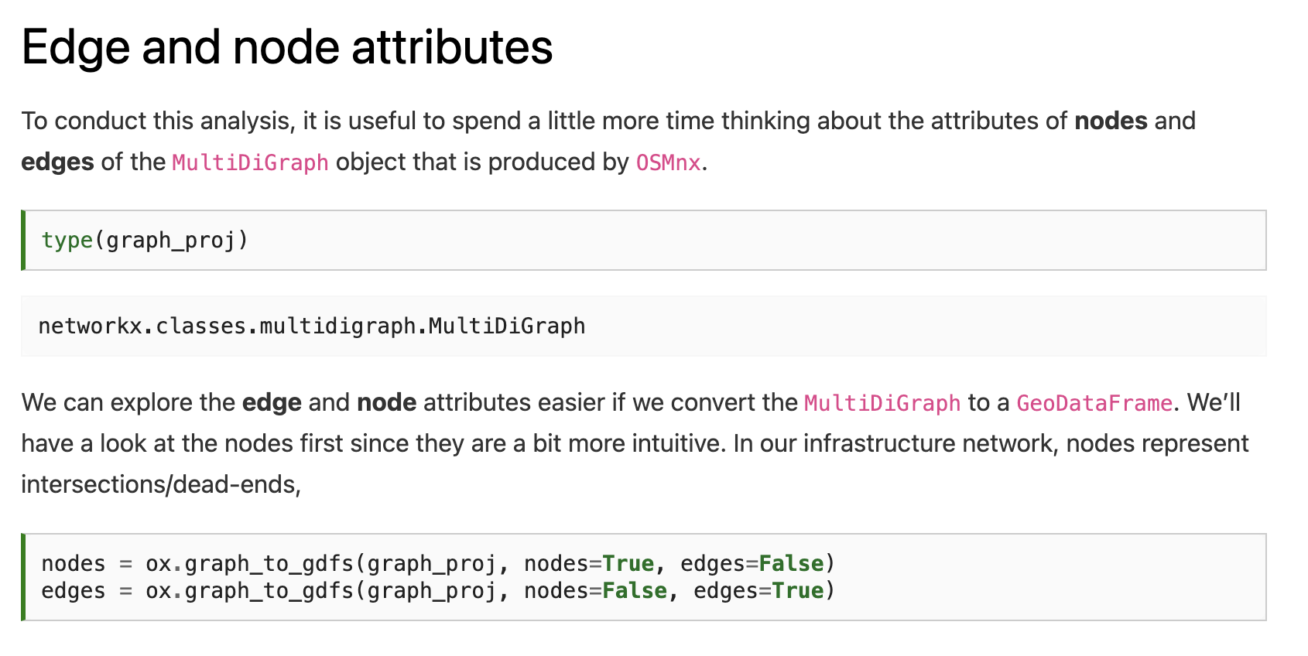

Slide 36
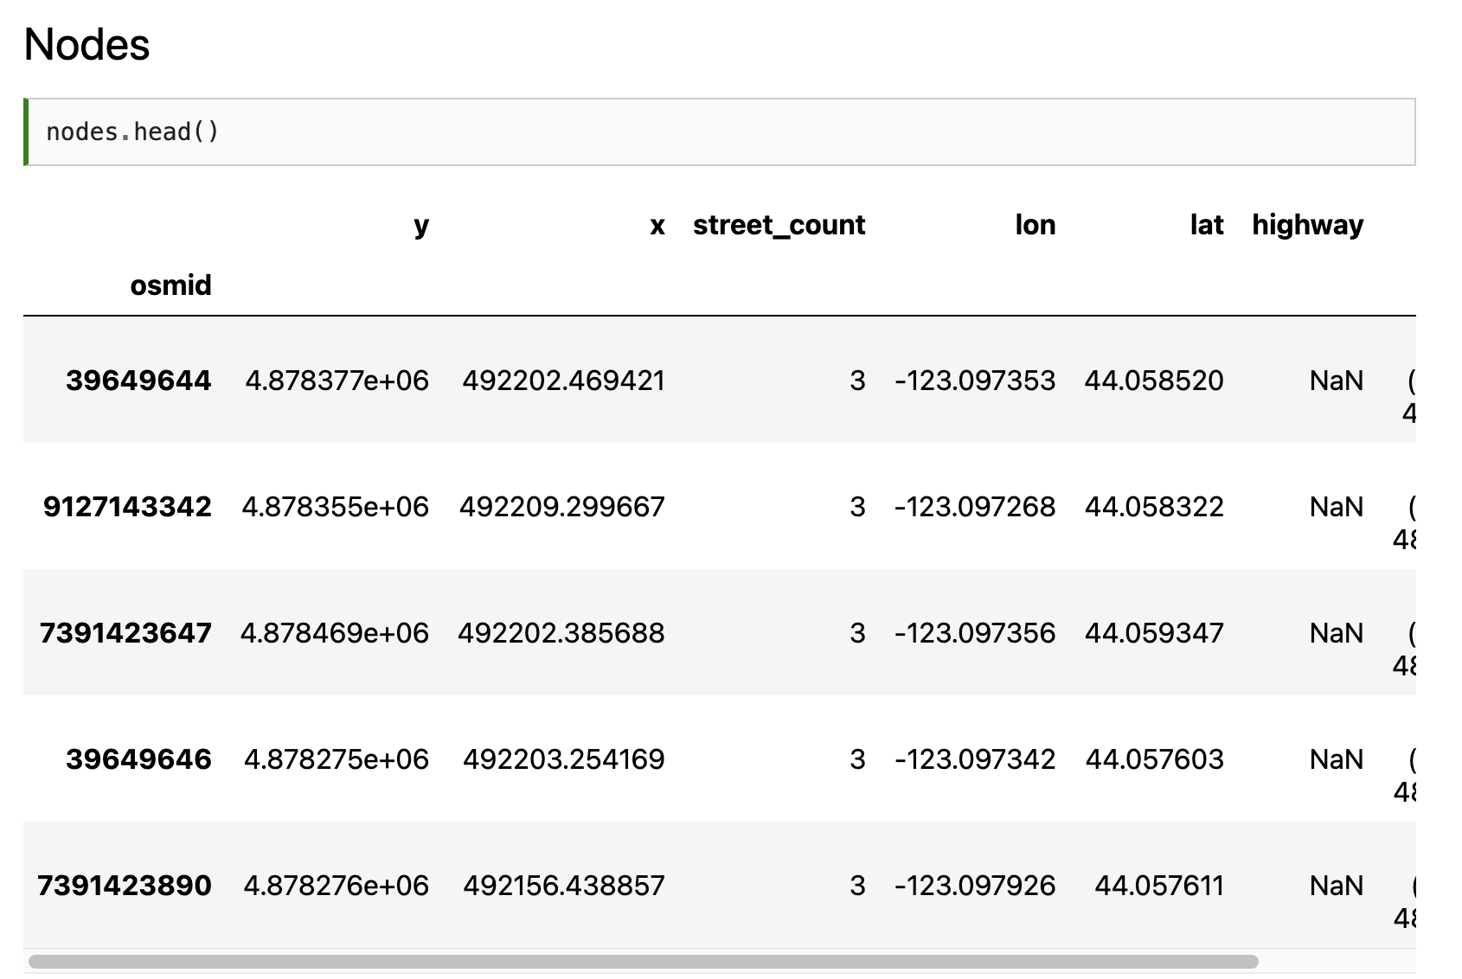
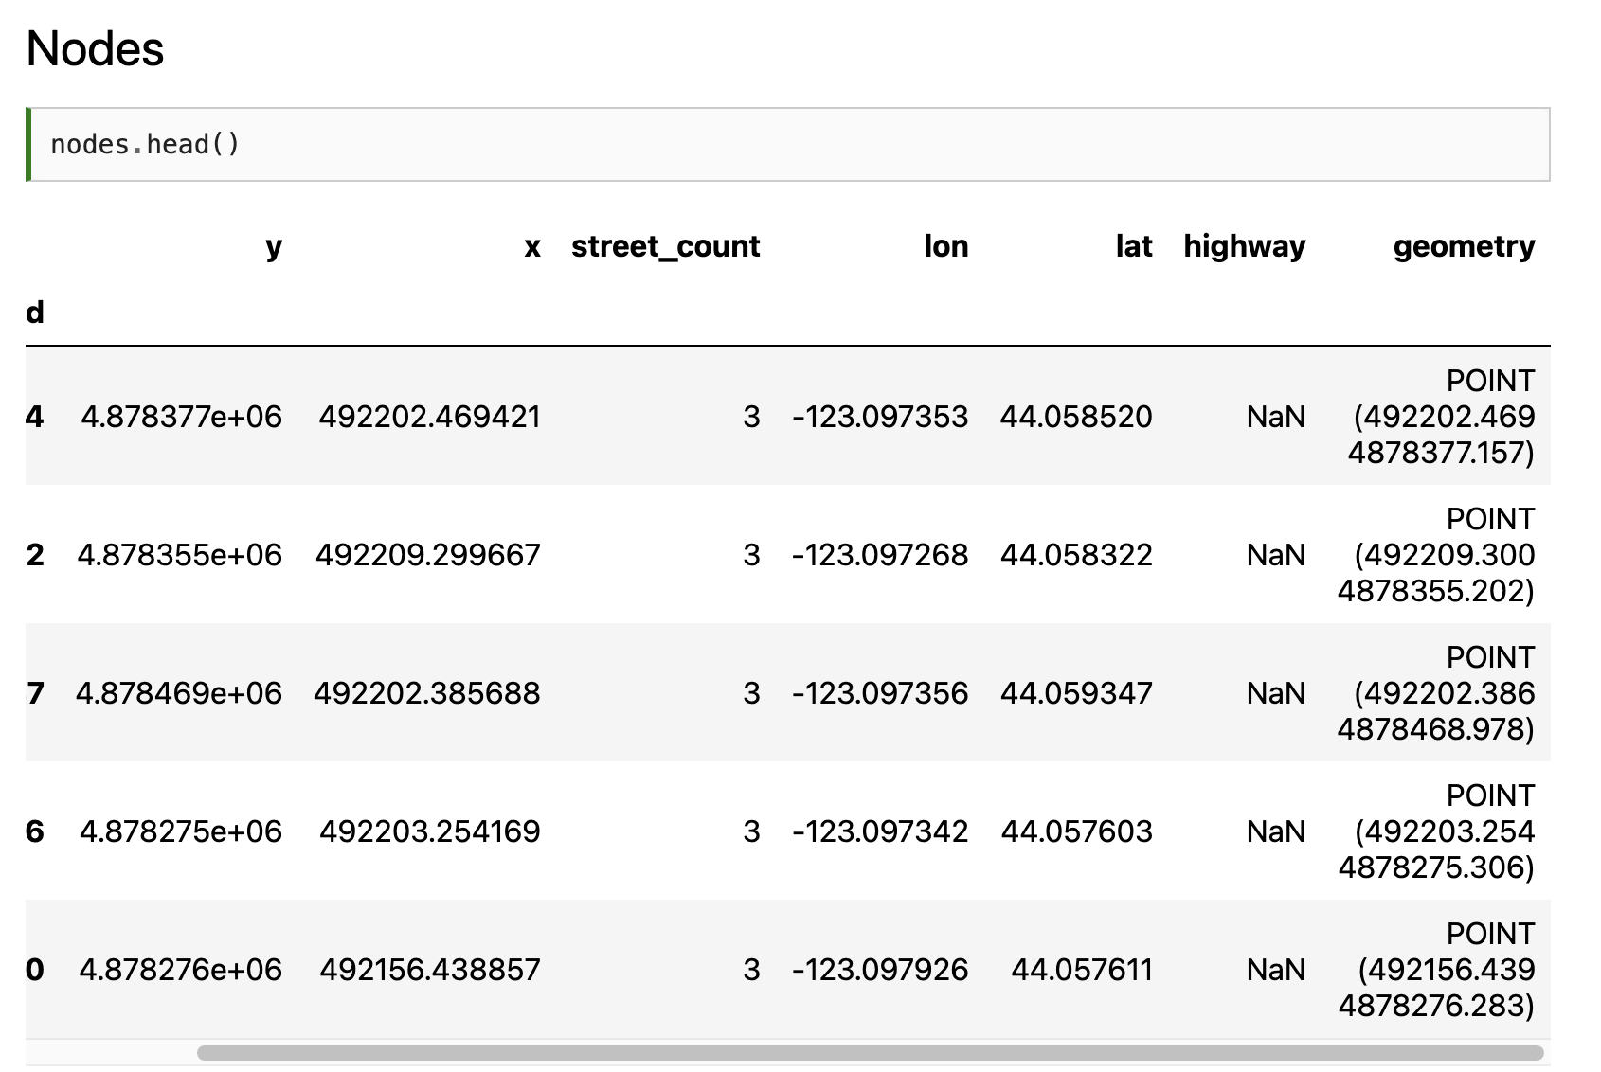

Slide 37
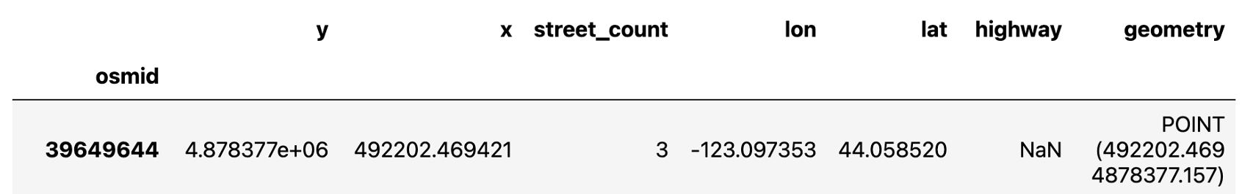
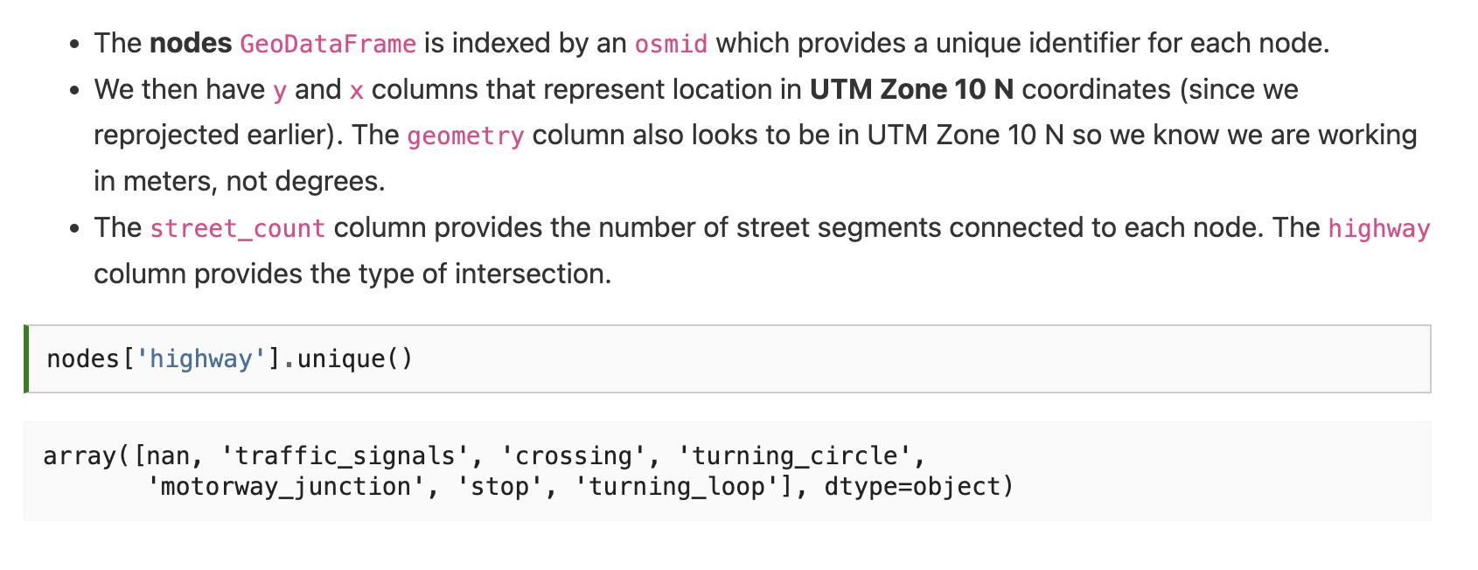

Slide 39
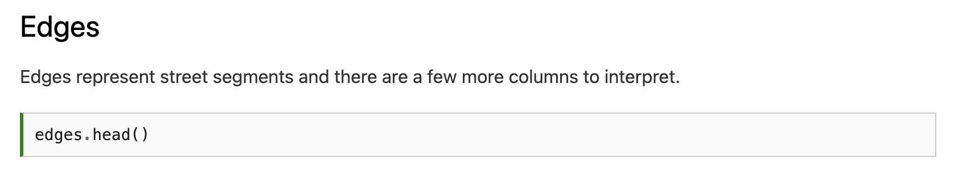
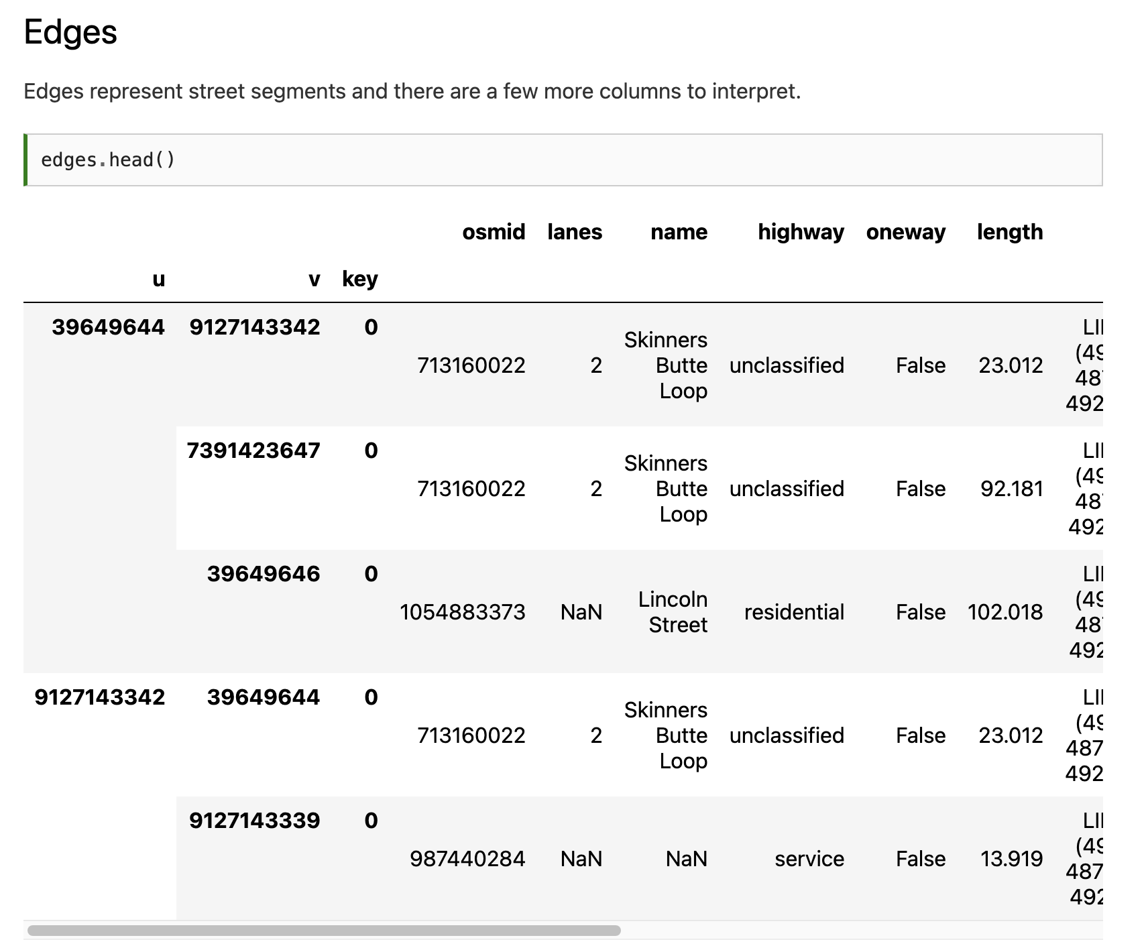
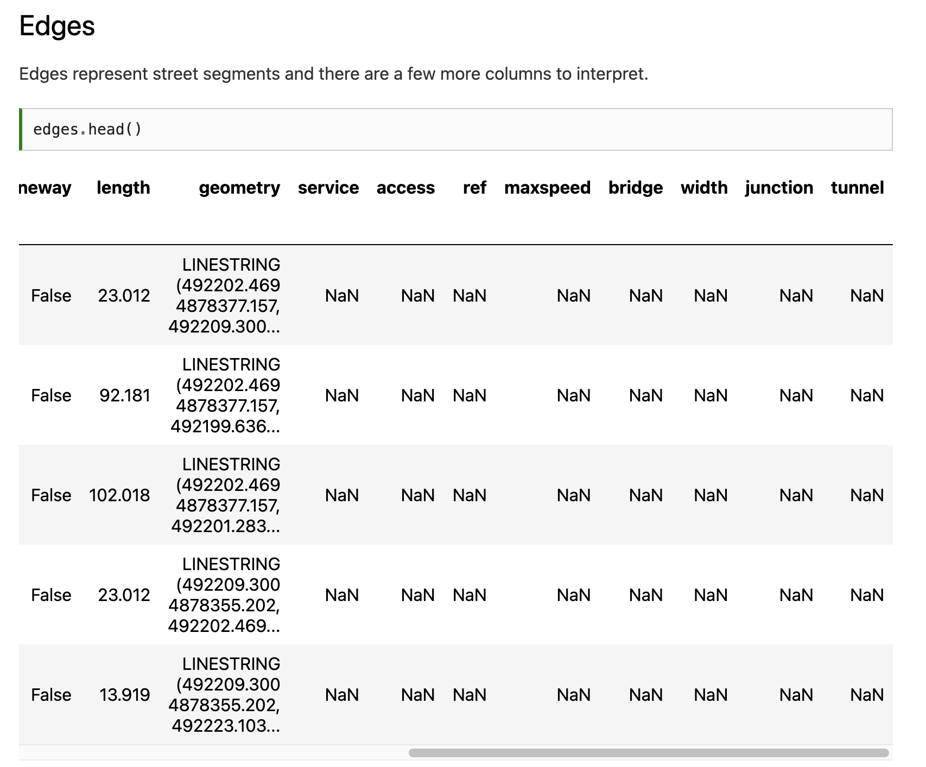

Slide 40
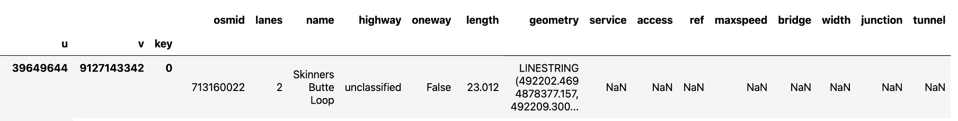
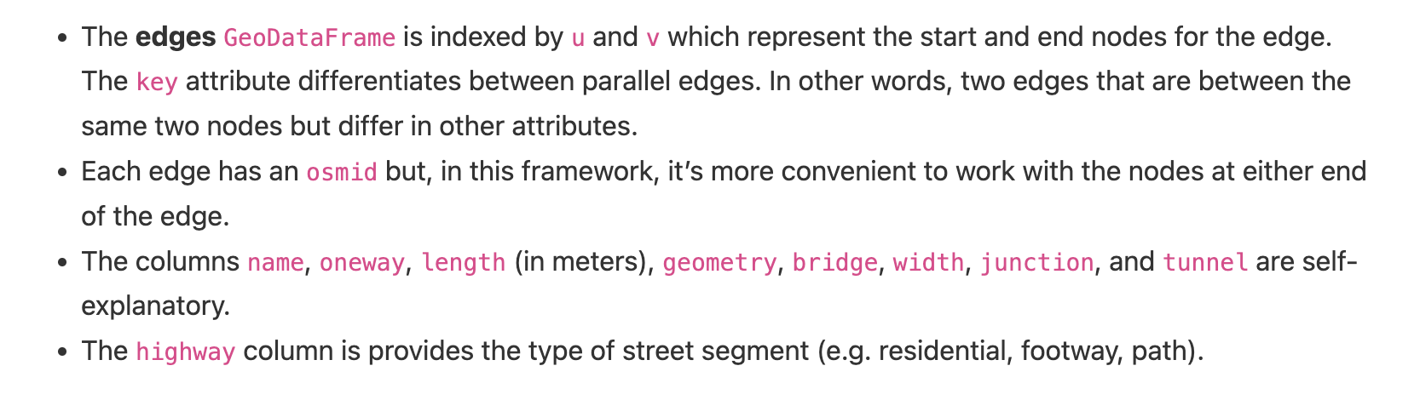

Slide 41
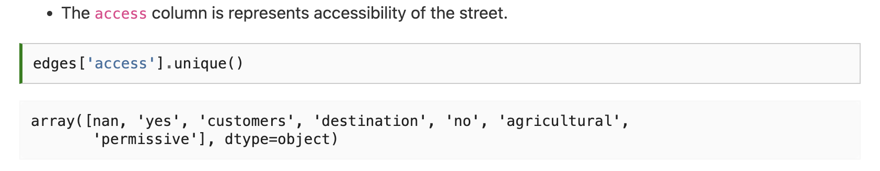

Slide 42
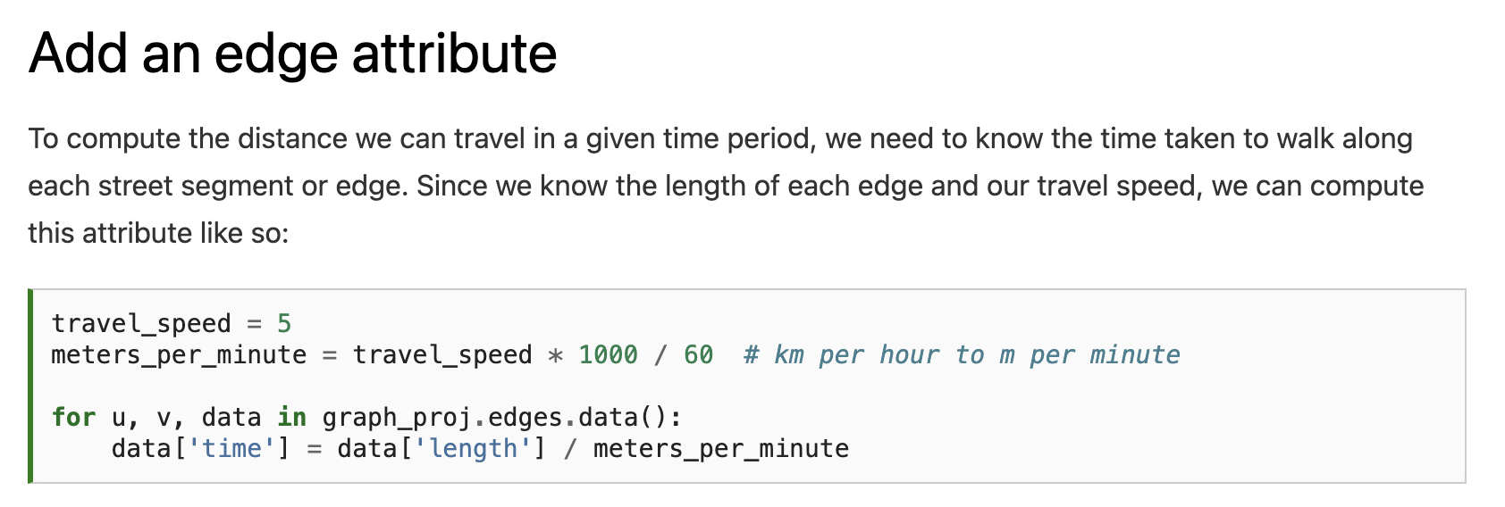

Slide 43
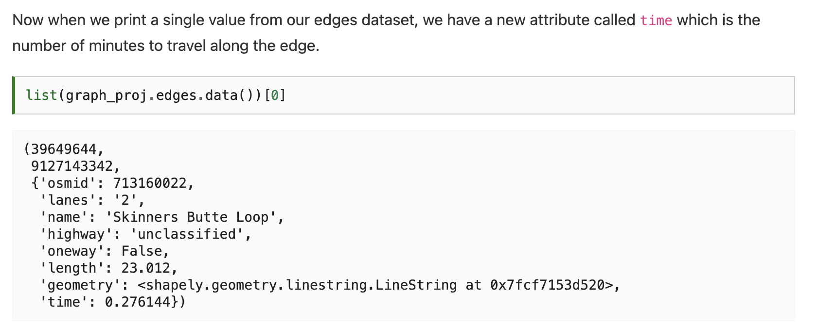

Slide 44
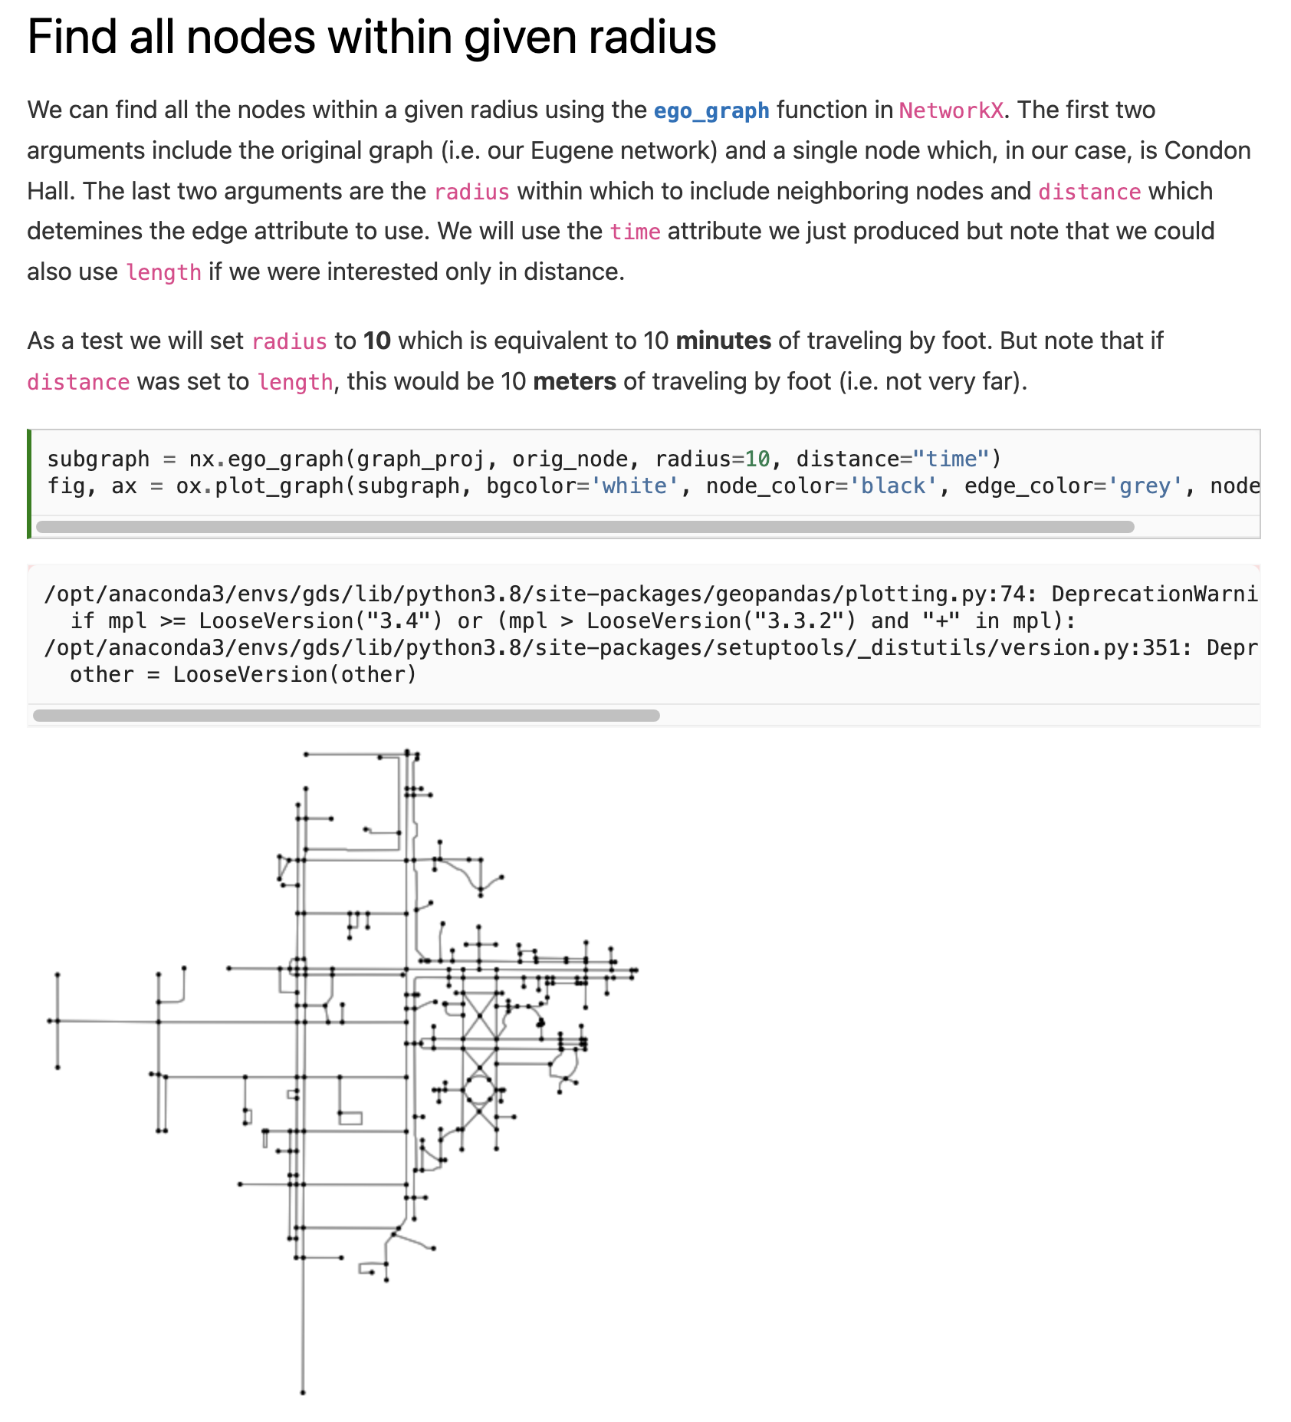

Slide 46
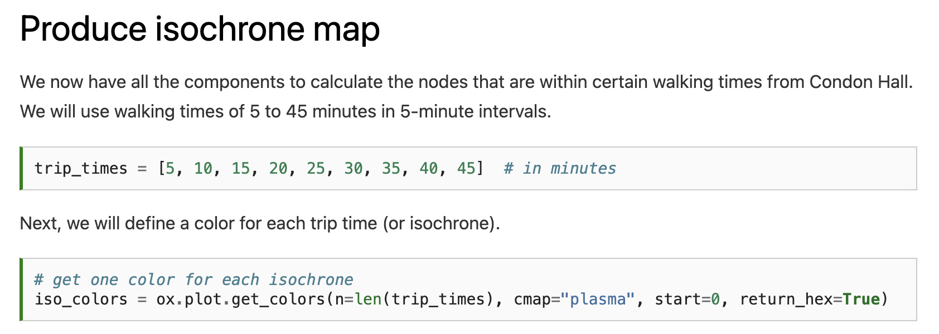

Slide 47
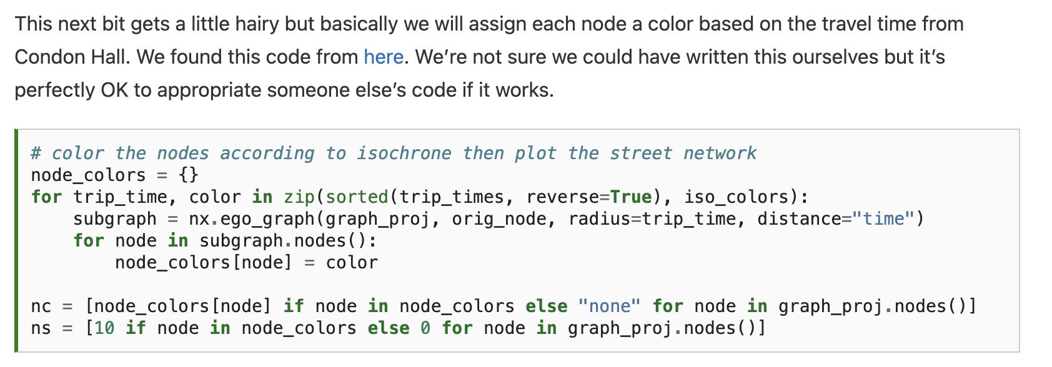

Slide 48
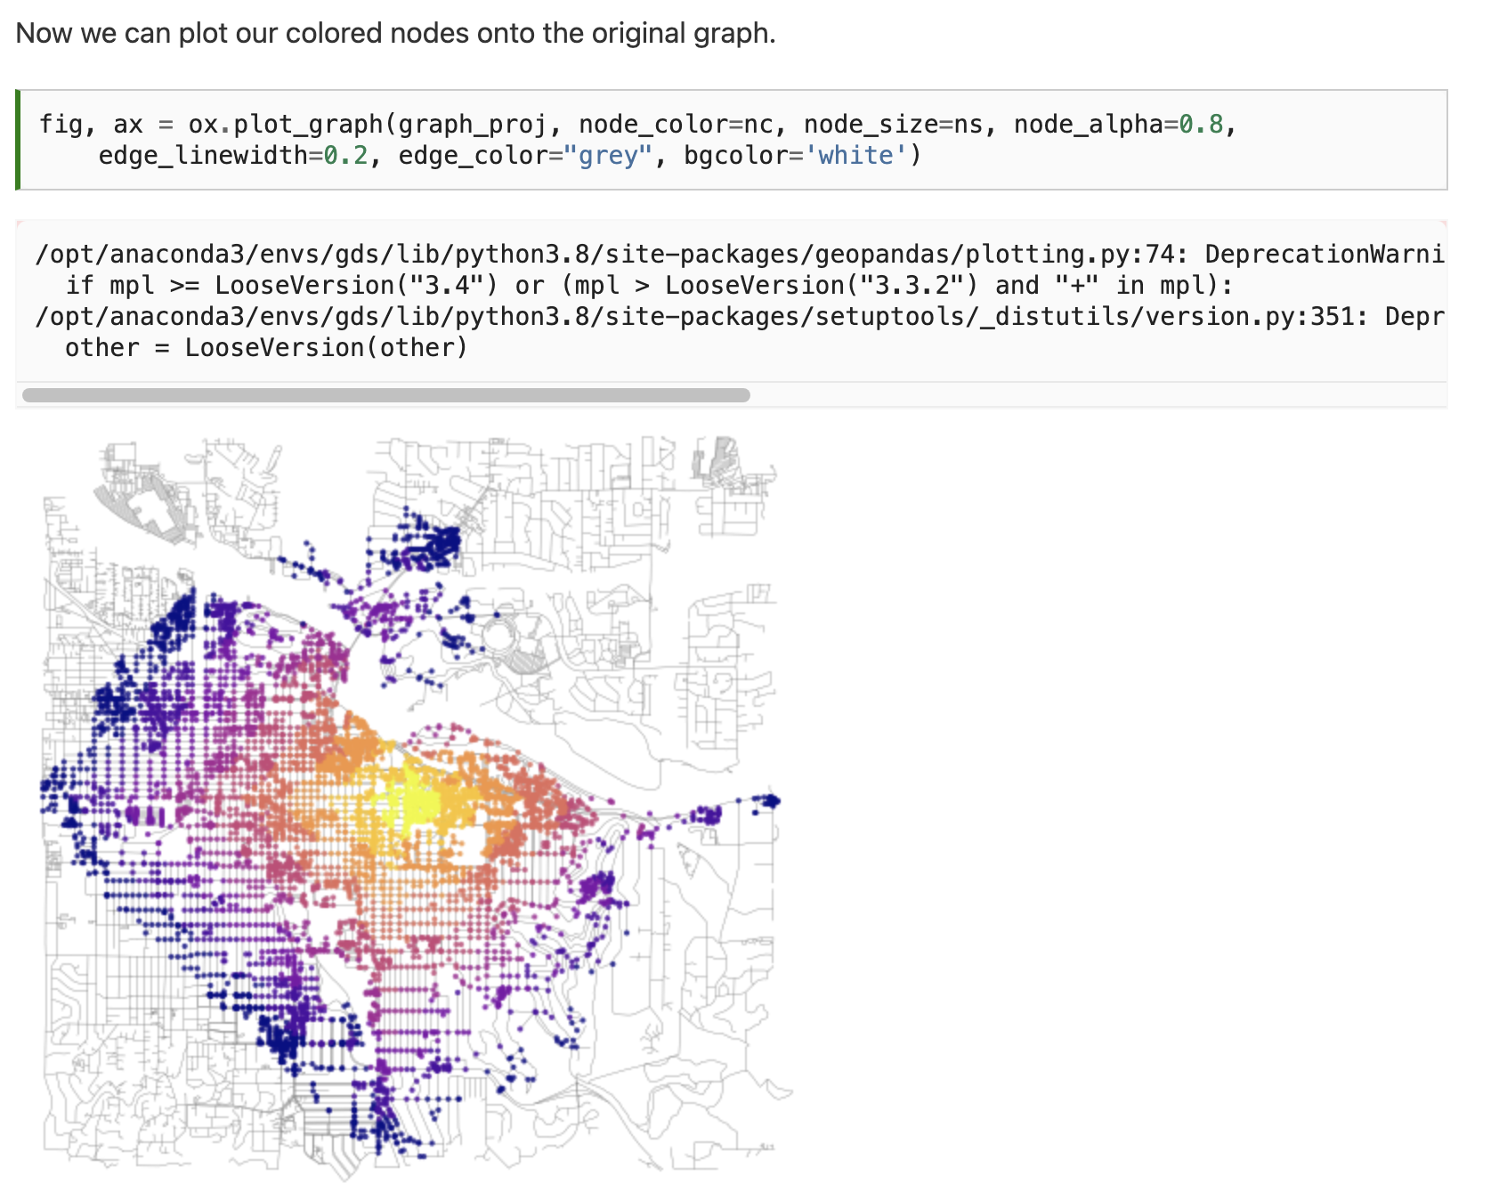
Notes:
This looks great but is of limited use since the buildings that we want to travel to are not necessarily associated with nodes. It would be more convenient to convert this data into polygons which we could use to intersect buildings (or points) of interest.

Slide 49
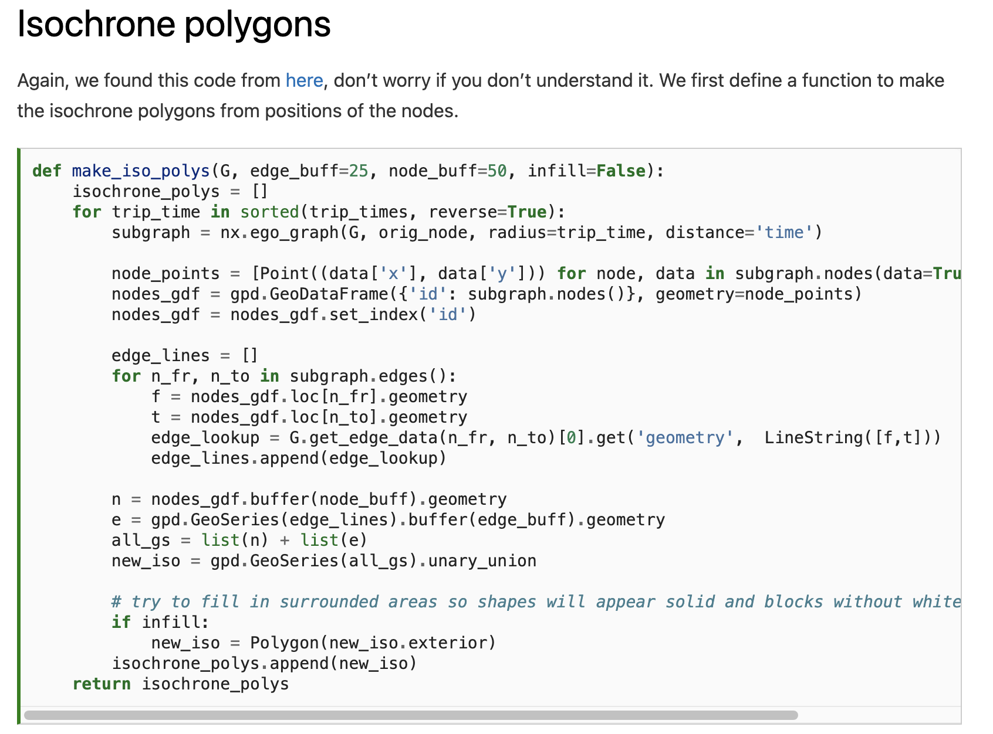
Notes:
This looks great but is of limited use since the buildings that we want to travel to are not necessarily associated with nodes. It would be more convenient to convert this data into polygons which we could use to intersect buildings (or points) of interest.

Slide 50
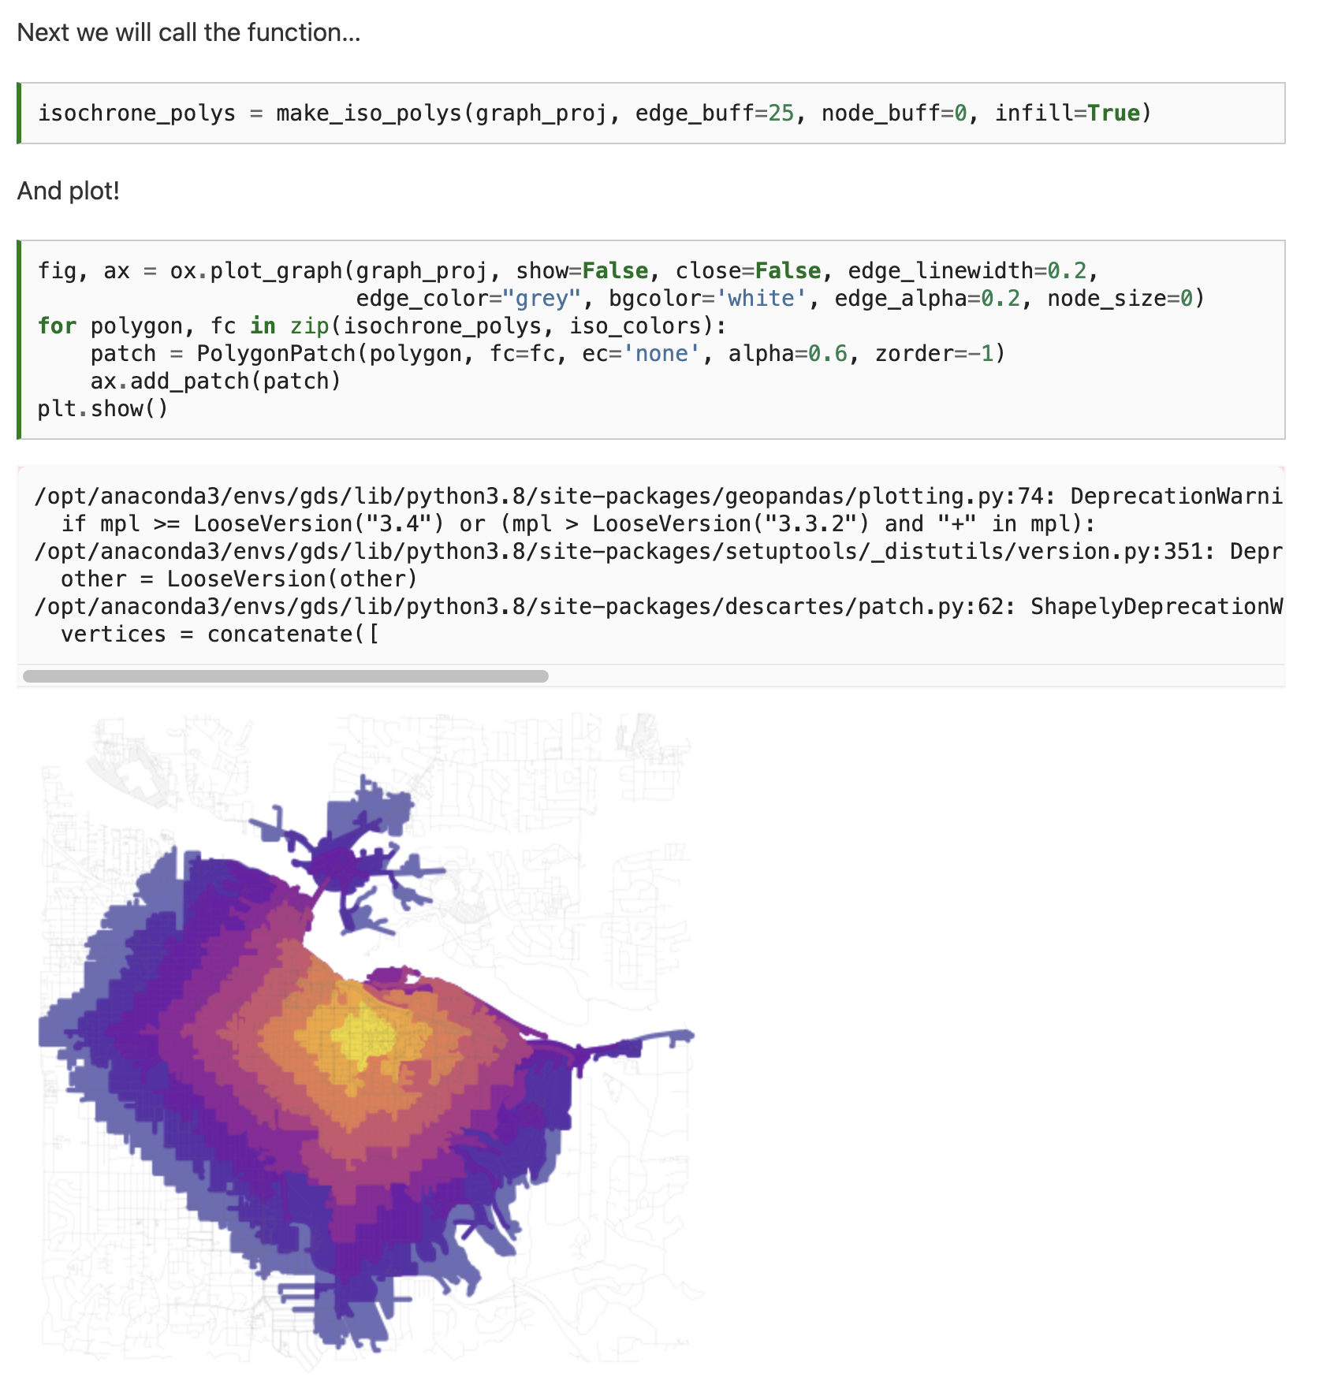
Notes:
This looks great but is of limited use since the buildings that we want to travel to are not necessarily associated with nodes. It would be more convenient to convert this data into polygons which we could use to intersect buildings (or points) of interest.

Slide 51
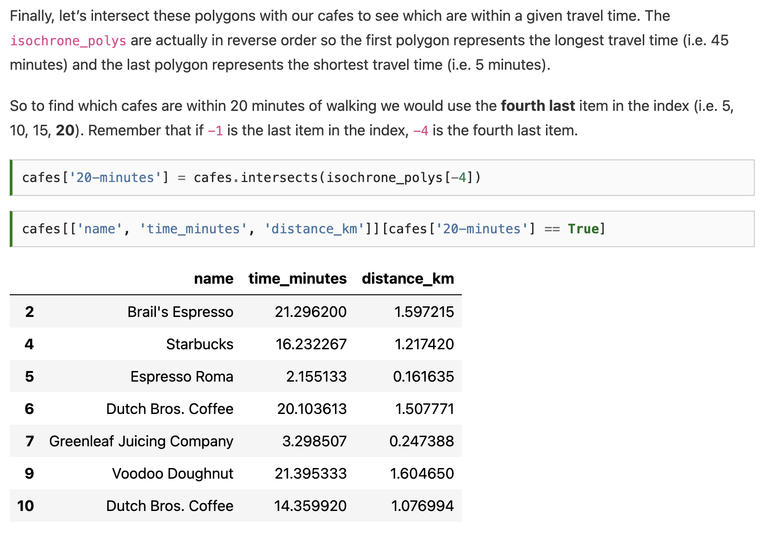
Notes:
This looks great but is of limited use since the buildings that we want to travel to are not necessarily associated with nodes. It would be more convenient to convert this data into polygons which we could use to intersect buildings (or points) of interest.

Slide 52
Notes:
This looks great but is of limited use since the buildings that we want to travel to are not necessarily associated with nodes. It would be more convenient to convert this data into polygons which we could use to intersect buildings (or points) of interest.

Slide 53
Next time: Gridded data analysis
Email: jryan4@uoregon.edu
Office: 163A Condon Hall
Office hours: Monday 14:00-16:00

